Slide 1
Java If-else Statement
The Java if statement is used to test the condition. It checks boolean condition: true or false. There are various types of if statement in Java.
if statement
if-else statement
if-else-if ladder
nested if statement

Slide 2
Java if Statement
The Java if statement tests the condition. It executes the if block if condition is true.
Syntax:
if(condition){
//code to be executed
}

Slide 3
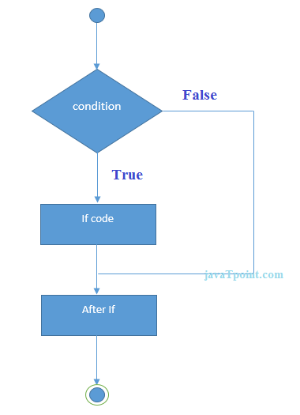

Slide 4
//Java Program to demonstrate the use of if
statement.
public class IfExample {
public static void main(String[] args) {
//defining an 'age' variable
int age=20;
//checking the age
if(age>18){
System.out.println("Age is greater than 18");
}
}
}

Slide 5
Java if-else Statement
The Java if-else statement also tests the condition. It executes the if block if condition is true otherwise else block is executed.
Syntax:
if(condition){
//code if condition is true
}else{
//code if condition is false
}

Slide 6
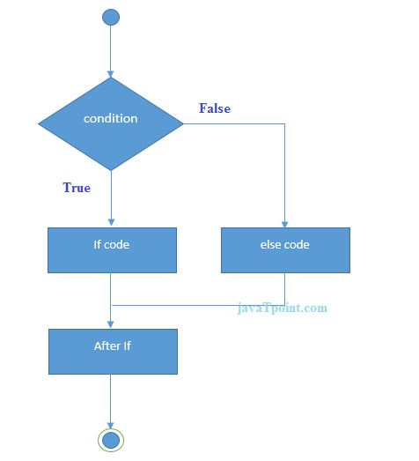

Slide 7
//A Java Program to demonstrate the use of if-else statement.
//It is a program of odd and even number.
public class IfElseExample {
public static void main(String[] args) {
//defining a variable
int number=13;
//Check if the number is divisible by 2 or not
if(number%2==0){
System.out.println("even number");
}else{
System.out.println("odd number");
}
}
}

Slide 8
Java if-else-if ladder Statement
The if-else-if ladder statement executes one condition from multiple statements.
Syntax:
if(condition1){
//code to be executed if condition1 is true
}else if(condition2){
//code to be executed if condition2 is true
}
else if(condition3){
//code to be executed if condition3 is true
}
...
else{
//code to be executed if all the conditions are false
}

Slide 9
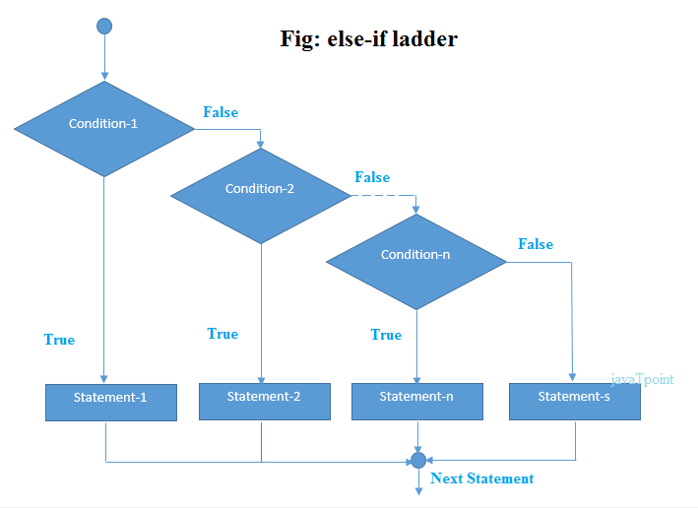

Slide 10
Program to check POSITIVE, NEGATIVE or ZERO:
public class PositiveNegativeExample {
public static void main(String[] args) {
int number=-13;
if(number>0){
System.out.println("POSITIVE");
}else if(number<0){
System.out.println("NEGATIVE");
}else{
System.out.println("ZERO");
}
}
}

Slide 11
Java Nested if statement
The nested if statement represents the if block within another if block. Here, the inner if block condition executes only when outer if block condition is true.
Syntax:
if(condition){
//code to be executed
if(condition){
//code to be executed
}
}

Slide 12
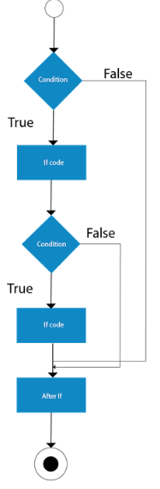

Slide 13
//Java Program to demonstrate the use of Nested If Statement.
public class JavaNestedIfExample {
public static void main(String[] args) {
//Creating two variables for age and weight
int age=20;
int weight=80;
//applying condition on age and weight
if(age>=18){
if(weight>50){
System.out.println("You are eligible to donate blood");
}
}
}}

Slide 14
//Java Program to demonstrate the use of Nested If Statement.
public class JavaNestedIfExample2 {
public static void main(String[] args) {
//Creating two variables for age and weight
int age=25;
int weight=48;
//applying condition on age and weight
if(age>=18){
if(weight>50){
System.out.println("You are eligible to donate blood");
} else{
System.out.println("You are not eligible to donate blood");
}
} else{
System.out.println("Age must be greater than 18");
}
} }

Slide 15
A year is leap, if it is divisible by 4 and 400. But, not by 100. ----------------------------------------- program of grading system for fail, D grade, C grade, B grade, A grade and A+.

